Slide 1

Analysis 1: Foundations of Modeling Lesson 3.2: Boolean logic and branching algorithms
Analysis Team, 2020/2021

Slide 2
Overview of this lesson: Boolean logic and branching algorithms
Boolean logic in Python,
Logical variables, operators and the order,
Comparison and conditions,
Branching algorithms.

Slide 3
Overview of this lesson: Boolean logic and branching algorithms
Learning objectives:
Understand Boolean values and related operators in Python.
Learn how to write and test logical conditions.
Learn how to control the flow of a program with IF statements.
Understand branching algorithms and solve simple problems with branching algorithms.
At the end of the lesson a student should be able to:
Use Boolean values and expressions in conditional statements.
Solve a simple problem requiring a branching algorithm.

Slide 4
Boolean logic in Python

Slide 5
Recap – Boolean logic
What is Boolean logic / Boolean algebra?
Which values can variables have in Boolean algebra?
Which operations do you remember?
What are fundamental operations?

Slide 6
Recap – variables
What are variables? What is their purpose?
Which variable types did we mention so far?

Slide 7
Logical variables in Python
Logical variables are declared and assigned values the same way as any other variable in Python.
These values can be logical TRUE and logical FALSE.
IMPORTANT: Python makes distinction between uppercase and lowercase!
The correct syntax for logical values is:
True
False

Slide 8
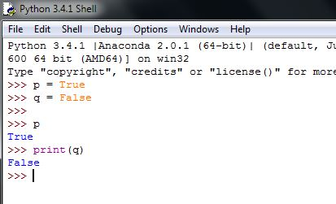
Logical variables in Python
Let’s declare two variables p and q and assigned them logical True and logical False values.
Try:
p = True (PRESS ENTER)
q = False (PRESS ENTER)
Let’s test everything by printing out their values.
Try:
p (PRESS ENTER)
Or
print(q) (PRESS ENTER)

Slide 9
Logical variables in Python
Let’s add fundamental operators.
All logical operators in Python are written using lowercase.
Example:
and
or
not
Do you remember which one was unary (takes only one operand / input value)?

Slide 10
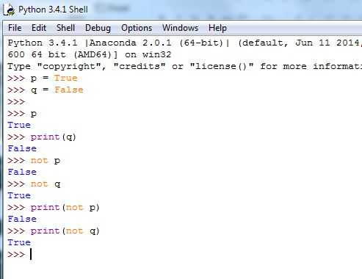
not operator
not is a unary operator that negates a value.
Let’s try using not with our variables p and q.
Try:
not p (PRESS ENTER)
not q (PRESS ENTER)
What do you get as result?

Slide 11
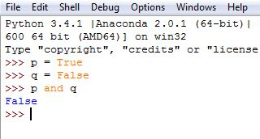
and operator
and is a logical operator that returns true if all operands are true. Otherwise, it returns false.
So what should (p and q) return?
Let’s try it on variables p and q…
Type
p and q (PRESS ENTER)
Is this correct?

Slide 12
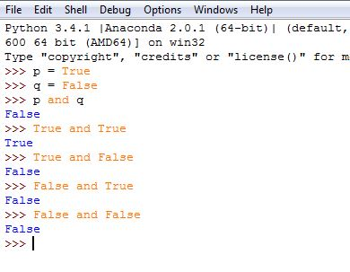
and operator
Next, let’s check if Python does Boolean arithmetics properly.
Enter all values from the and truth table.
Type
True and True (PRESS ENTER)
True and False (PRESS ENTER)
False and True (PRESS ENTER)
True and False (PRESS ENTER)
Is this correct?

Slide 13
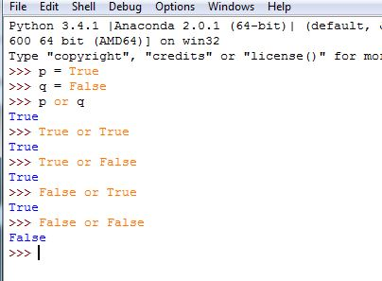
or operator
Finally, we will do the same for or operator.
or is a logical operator that returns false if all operands are false. Otherwise, it returns true.
Experiment with or operator for variables p and q…
Try explicitly entering values from or truth table.

Slide 14
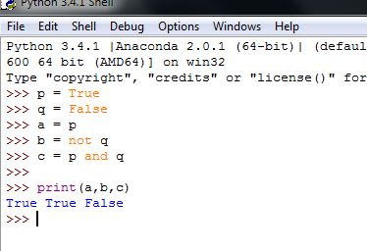
Practice with logical variables and operators
Now that we know how to declare Boolean variables and use Boolean operators, let’s practice with simple expressions…
We will keep p and q, with p = True and q = False.
Let’s add three more variables: a, b and c.
Set:
a to the same value as p,
b to the opposite value of q,
c to the result of p and q.

Slide 15
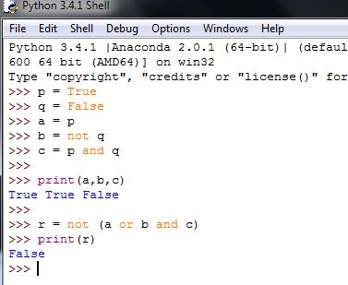
Practice with logical variables and operators
Continue practicing with expressions with more variables in operators.
For example, try:
r = not (a or b and c)
What do you expect to get?
This is a good moment to discuss the order of operations.

Slide 16
Order of logical operations
In Python, not has higher priority than and and or operators.
Expressions in parentheses are evaluated first.
But, how can we be sure?
Can you think of a test to confirm that not is indeed executed before and and or?

Slide 17
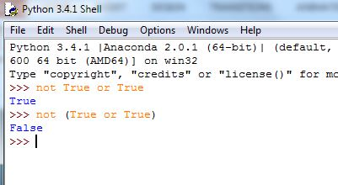
Order of logical operations
Type:
not True or True
not (True or True)
Let’s assume (wrongly) that or is evaluated first. That would lead to:
not True or True = not True = False
However, if we assume that not is evaluated first that would lead to:
not True or True = False or True = True
… and that is the result we got.
The second line shows how parenthesis ( ) change the priority.

Slide 18
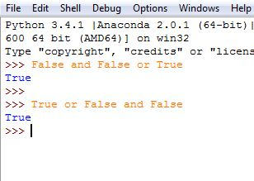
Order of logical operations
Let’s do the same for and and or.
Try to think of an expression.
If you get stuck, use the following:
False and False or True
True or False and False
Based on the results, what do you conclude?
Do and and or have the same priority?
Or is one of them evaluated first?

Slide 19
Order of logical operations
The example shows that actually and is evaluated BEFORE or.
Therefore, the order of logical operations in Python is:
parentheses ( )
not
and
or
If you are in doubt, use parentheses.
False
False

Slide 20
Comparisons and conditions

Slide 21
Comparison operators
Comparison operators are used to compare two values.
In Python we have:
Comparison operator will always return a Boolean value (True or False).
Operator | Name | Example
== | equal | x == y
!= | not equal | x != y
> | greater than | x > y
< | less than | x < y
>= | greater than or equal to | x >= y
<= | less than or equal to | x <= y

Slide 22
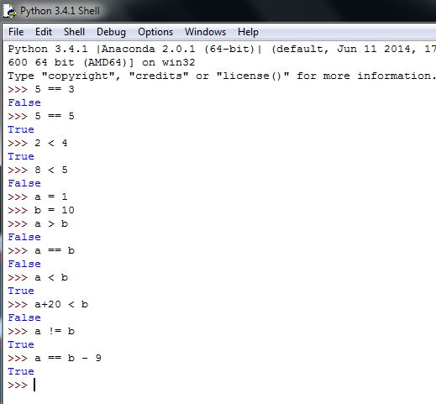
Comparison operators
This is self-explanatory, so we will only try a few:
5 == 3
5 == 5
2 < 4
8 < 5

Slide 23
Comparison operators
Feel free to add variables and expressions:
a = 1
b = 10
a > b
a == b
a < b
a + 20 < b
a != b
a == b - 9

Slide 24

Assigning vs comparing values
A very common mistake with
novice programmers is to use assignment operator (=) in place of comparison operator (==)!
-----------------------
A == B compares A and B returning either True or False!
A = B will bind the value variable B has to variable A!!!

Slide 25
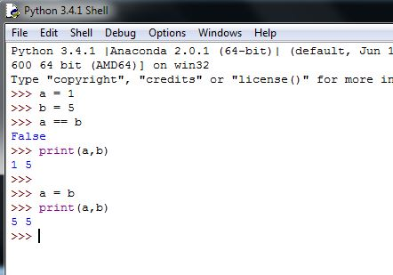
Assigning vs comparing values (typical error)
This illustrates an error that often occurs with beginners to programming.
If you mistakenly use ‘ = ’ assignment instead of ‘ == ’ comparison – equal, you will overwrite one of the variables!

Slide 26
Conditions
There is a saying that “true programming” starts the moment we introduce conditions.
So far, we have covered Boolean variables, operators and comparison.
This gives us all the tools we need to move on to conditions.
Conditions in Python are if … (then) … else … statements that direct the flow of the program.

Slide 27
if … (then) …
if … (then) … is the first condition we will cover.
It starts with the if keyword, followed by an expression (Boolean value or condition).
After the expression we use the : sign (colon) to denote the end of the expression.
At the end (new line, plus indentation) we add one or more statements (program lines).
When Python encounters if … (then) … statement, it will:
Evaluate the expression,
If the expression is True
Python will execute statements after the : sign.
If not, it will just skip them and do nothing.

Slide 28
if … (then) …
This is some expression that must evaluate to True or False.
E.g. A > 0, M != N, not(P and Q), True, …
Let’s take a closer look:
if expression:
statement(s)
‘ : ‘ denotes the end of expression; it can be read as THEN
One or more program statements.
It is these statements that will be
executed if expression == True.
This is the keyword that tells Python we are using an IF statement

Slide 29
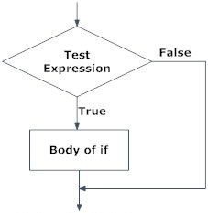
if … (then) …
Below you can find the flowchart for if statements in general.

Slide 30
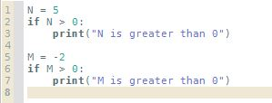

if … (then) …
Running lines 1 – 7 …
… gives the following output:
N > 0 → 5 > 0 → True
Statement from the body is executed.

Slide 31
if … (then) …
Running lines 1 – 7 …
… gives the following output:
M > 0 → -2 > 0 → False
Statement from the body is NOT executed.

Slide 32

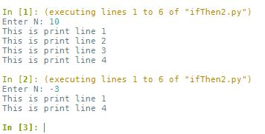
if … (then) …
Next is the example with TWO lines in the body of if statement.
Line 1 will ask for N.
Line 2 will be executed regardless.
Line 3 is the if statement where N will be tested if it is greater than 0.
Lines 4 and 5 are executed ONLY if N > 0.
Line 6 is outside of the if statement, so it will be executed regardless of it.

Slide 33
if … else …
Often, you will want one group of statements to be executed if some condition is met, and others if not.
This can be accomplished with two opposite if statements, but that would be a waste.
Hence, we have if … else statement, which is the same as if … statement (contains if keyword, expression and body) …
… PLUS the addition of else keyword and : sign
In the new line after else (plus indentation) are statements that are to be executed if expression was evaluated to be false.

Slide 34
if … else
This is some expression that must evaluate to True or False.
E.g. A > 0, M != N, not(P and Q), True, …
Let’s take a closer look:
if expression:
statement(s)
else:
statement(s)
‘ : ‘ denote the end of expression; it can be read as THEN
One or more program statements.
It is these statements that will be
executed if expression == True.
else keyword followed by ‘ : ‘ sign
One or more program statements.
It is these statements that will be
executed if expression != True.
This is the keyword that tells Python we are using IF statement

Slide 35
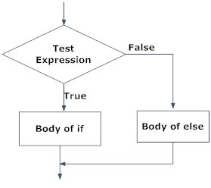
if … else …
Below you can find the flowchart for if else in general.

Slide 36

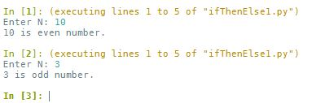
if … else …
The following example uses modulo division to check if N is even.
For N = 10, expression = True (10 % 2 == 0), and line 3 is executed.
For N = 3, expression = False (3 % 2 != 0), and line 5 is executed.
Executed when condition is True
Executed when condition is False

Slide 37
if … elif … else …
If you want to check for multiple expressions, you can use if … elif … else … condition.
Alternatively, you can nest multiple if … else … conditions.
elif is short for else if.
It builds upon if … else … adding one or more elif keywords followed by test expressions and body with the statement(s) to be executed.
Note: if … elif … else … can have MULTIPLE elif(s) but only ONE else.
Else is executed if NO CONDITIONS have been met.

Slide 38
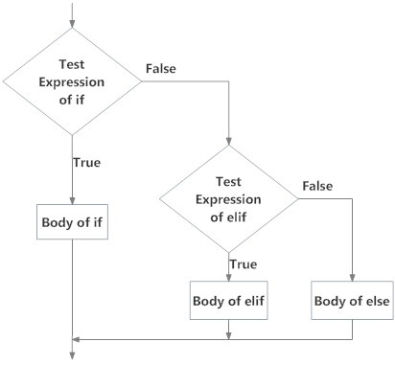
if … elif … else …
Below you can find the flowchart for if elif else in general.

Slide 39
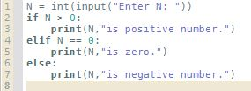
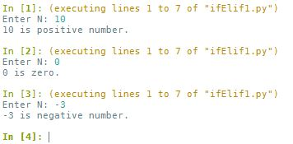
if … elif … else …
An example that checks if N is greater than 0 (line 2). If True, line 3 will be executed. If not, it will check if N is equal to 0 (line 4, elif). If condition in line 4 is True, then line 5 will be executed. If not, only then, line 7 will be executed.

Slide 40
Nesting if statements
The last example could have been realized with two nested if … else … statements.
Nesting is including one if … else … statement inside another.
Any number of statements can be nested inside one another. Only through indentation you can distinguish them.
NOTE: nesting too many statements reduces the clarity of the program.

Slide 41
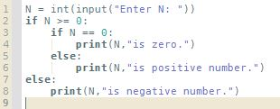
Nesting if statements
Below you can find the same problem rearranged to include two nested if statements:

Slide 42
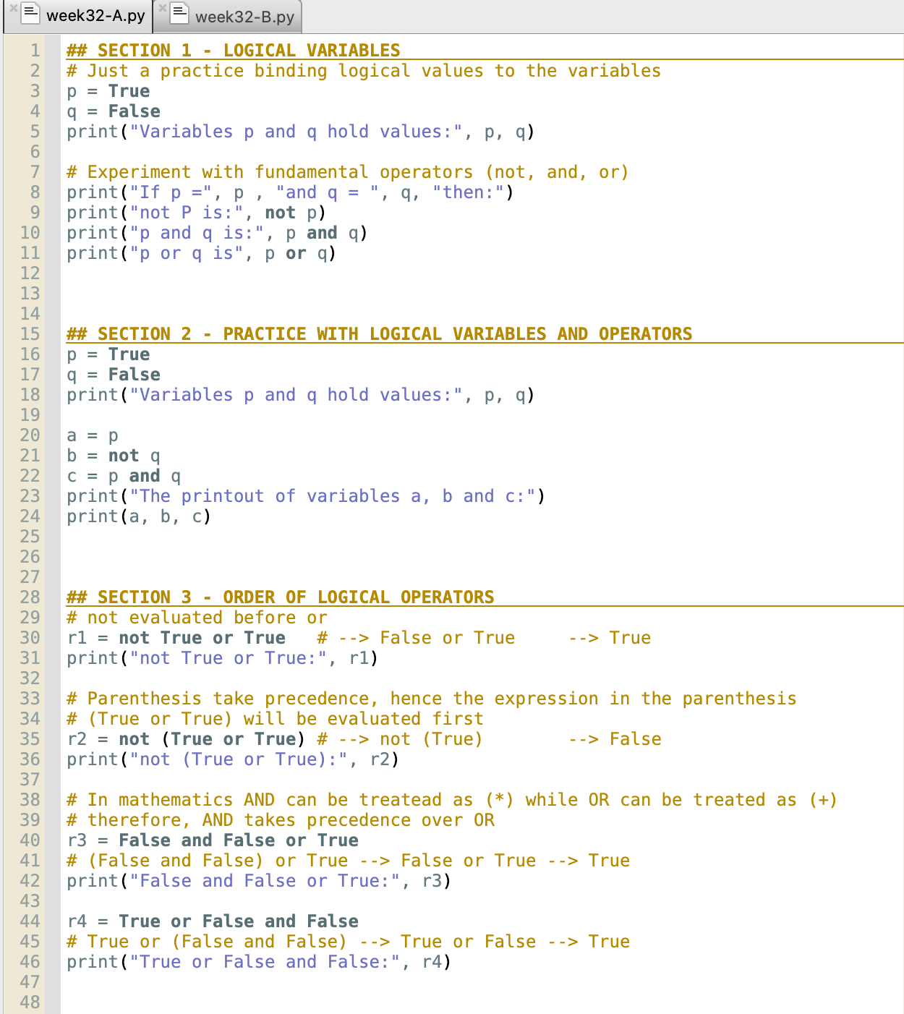
Practice with Pyzo (Spyder)
The code examples used in the previous slides can be found in the file week32-A.py.
Open it in Pyzo or Spyder and experiment.

Slide 43
Branching algorithms

Slide 44
Recap – basic algorithm types
In week 1 we mentioned 3 different types of algorithms.
Which ones did we mention?
What are linear algorithms?
What are branching algorithms?

Slide 45
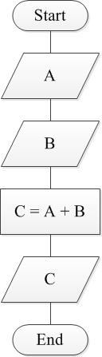
Linear algorithms
Linear algorithms are algorithms where every step is executed once and only once.

Slide 46
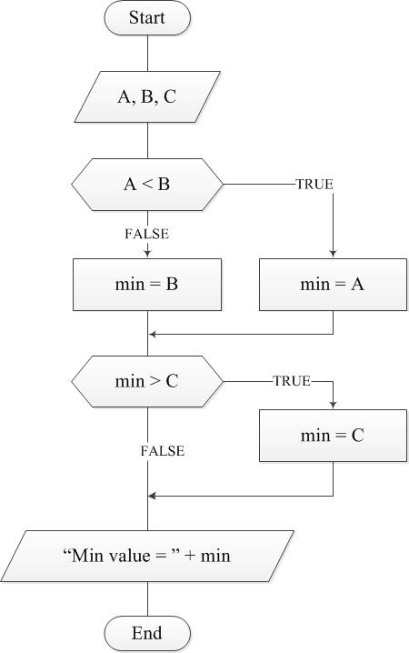
Branching algorithms
Branching algorithms contain steps that will be either executed ONCE or NEVER
Depending on the program logic, some steps will be executed and some will not.

Slide 47
Branching algorithm 1 – check number
Problem: Write a program that will ask user to input an arbitrary number N. Print:
“Positive” – if N is greater than 0 ( N > 0 )
“Zero” – if N is equal to 0 ( N == 0 )
“Negative” – if N is less than 0 ( N < 0 )
Since we already solved the problem and implemented the solution during our practice, there is no need to decompose it in detail. However, let’s take a look and discuss two possible solutions …

Slide 48
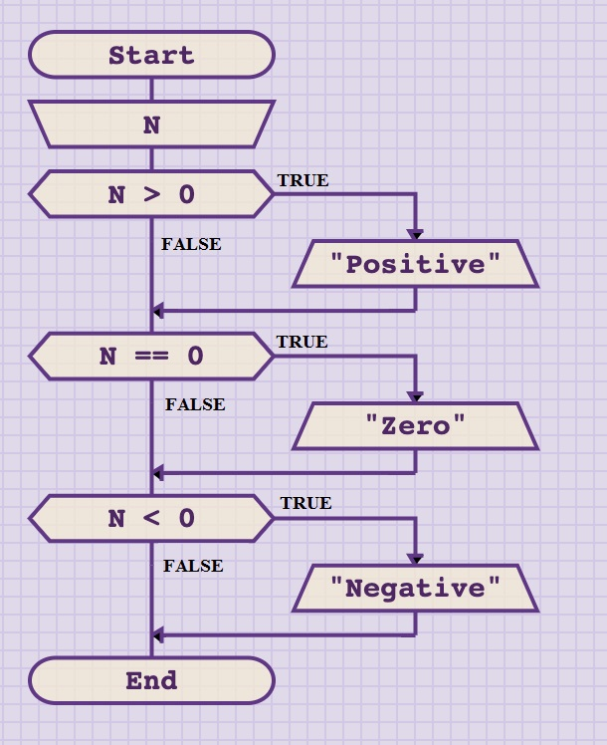
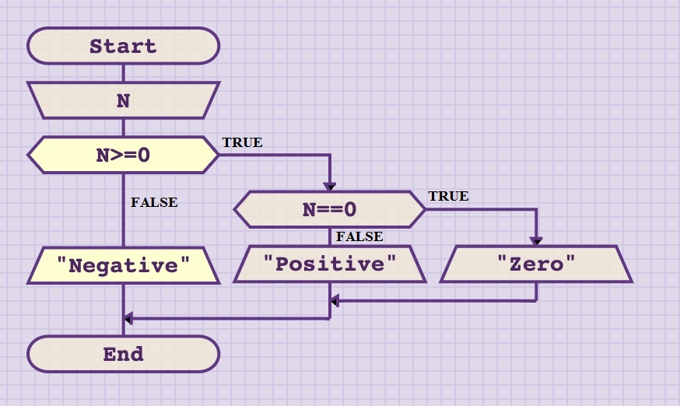
Branching algorithm 1 – check number
We can see from the flowcharts, that the same problem could have been solved in two different ways.
On the left there are 3 IF statements, on the right we use 2 IF … ELSE statements.

Slide 49
Branching algorithm 1 – check number
Next, let’s assume we don’t know what conditions were given in if statements. In that case, what are the possible outputs of each algorithm; i.e. what is the minimum possible number of outputs and maximum possible number of outputs?

Slide 50
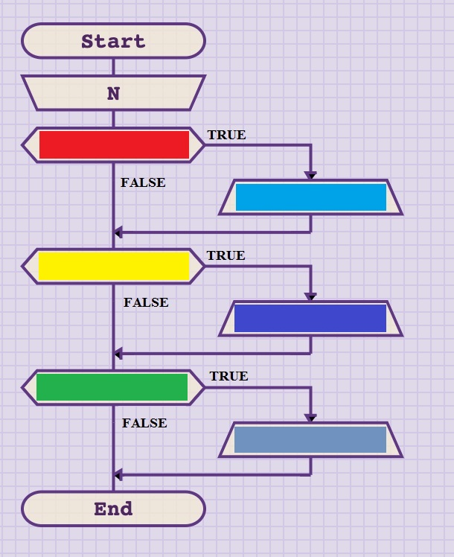
Branching algorithm 1 – check number
If we don’t know RED, YELLOW and GREEN condition, then we can guess that the number of outputs (BLUE, all shades):
0 – all statements were false
1 – one statement was true, others were false
2 – two statements were true, one was false
3 – all tree statements were true, all three outputs are printed.
Therefore, this approach can result in 0 – 3 output lines!

Slide 51
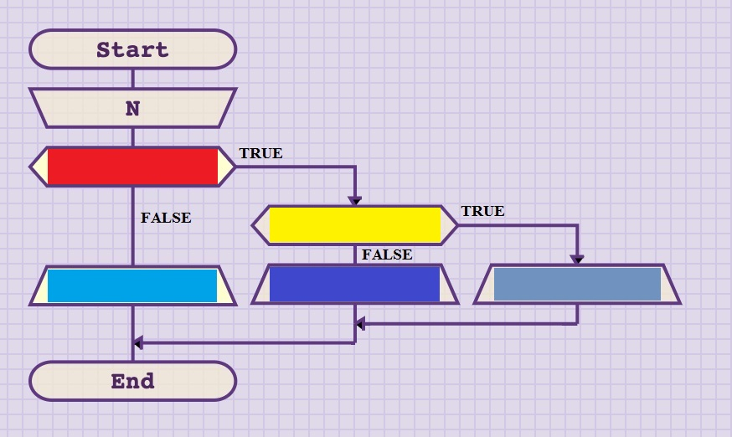
Branching algorithm 1 – check number
Here, the situation is different.
We will ALWAYS HAVE only one output.
If RED is true, then YELLOW will be evaluated. And if it is true, then the far right line will be executed.
If RED is true, but YELLOW is not, then the output in the middle will be executed.
If RED is false, then no further checks will be performed, and the output on the left will be executed.
Therefore, this approach will result in exactly 1 output line!

Slide 52
Branching algorithm 2 – greater number
Next, let’s do a “warm up” with simple if statement …
EXERCISE: Write a program that will ask user to input two numbers A and B. Then print the greater one.
Write the flowchart. Then implement it in Python.
Time: 5 minutes.

Slide 53
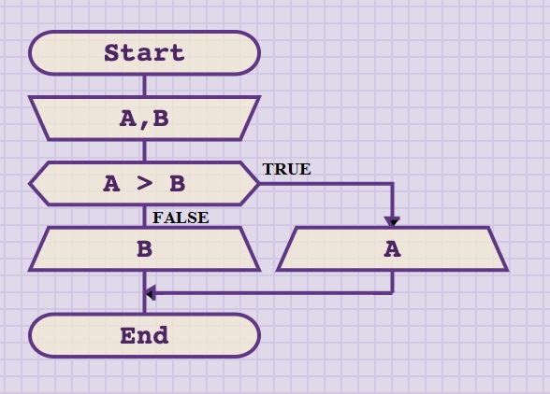
Branching algorithm 2 – greater number (solution – flowchart)
Easy, right?
OK, let’s “spice” it up…

Slide 54
Branching algorithm 3 – maximum
PROBLEM: Write a program that will ask user to input three numbers A, B and C. Then find the one with the maximum value and print it out.
One way to solve the problem is to “dive in” directly and start nesting IF statements…

Slide 55
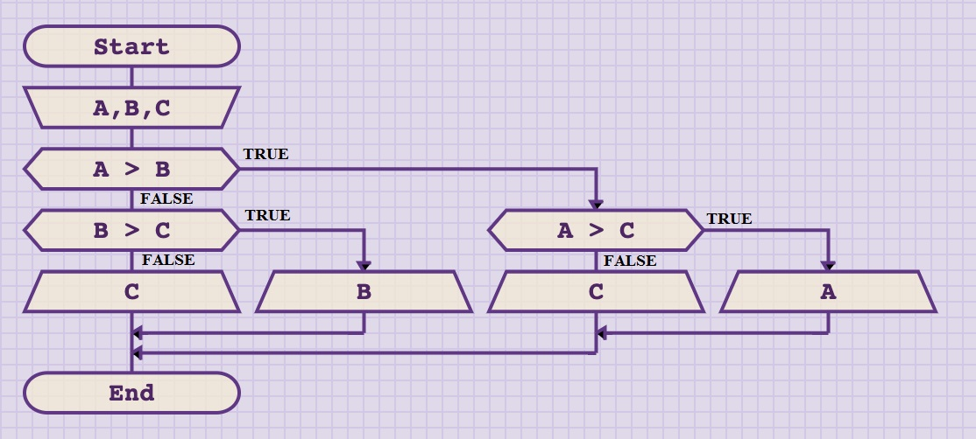
Branching algorithm 3 – maximum
Flowchart:

Slide 56
Branching algorithm 3 – maximum
Test case 1
A = 3, B = 2, C = 1
3 > 2
3 > 1
3

Slide 57
Branching algorithm 3 – maximum
Test case 2
A = 2, B = 3, C = 1
2 > 3
3 > 1
3

Slide 58
Branching algorithm 3 – maximum
Test case 3
A = 1, B = 2, C = 3
1 > 2
2 > 3
3

Slide 59
Branching algorithm 3 – maximum
Let’s discuss the solution. Is it good / bad?
Does it work?
Yes!
Is it good / bad?
How can we define good / bad?
Can we use it to solve more complex problems?
Can we find maximum of 4 numbers?
Can we find maximum of 10 numbers!?
Can we find maximum of 100 numbers!!!?

Slide 60
Branching algorithm 3 – maximum
In theory we can keep nesting IF statements.
In practice, we will start having problems already with 4, as the number of conditions increases exponentially. With 5 it becomes barely manageable, and beyond has no point discussing.
So … what can we do?

Slide 61

Branching algorithm 4 – max of 4
PROBLEM: Write a program that will ask user to input four numbers A, B, C and D. Then find the one with the maximum value and print it out.
To help us solve this, we will call our “pet”.
Max

Slide 62




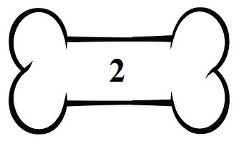


Branching algorithm 4 – max of 4
Max loves bones.
But Max can carry only one in his mouth.
Max wants the biggest bone.
But Max doesn’t know which one it is.

Slide 63

Branching algorithm 4 – max of 4
What Max can do is pick the first bone he finds.
If Max finds a new bone, he can compare the one he has with the new one.
The smaller ones, Max will just ignore.

Slide 64
Branching algorithm 4 – max of 4
When Max finds a bigger bone …
Max will drop the one has….
Max then picks the new one.

Slide 65
Branching algorithm 4 – max of 4
Repeating the process …
Max will end up with the largest bone!!!

Slide 66
Branching algorithm 4 – max of 4
Conclusion: the problem is easily solved by adding the helper variable – Max, that will:
Store the highest value,
Be used for comparison.

Slide 67
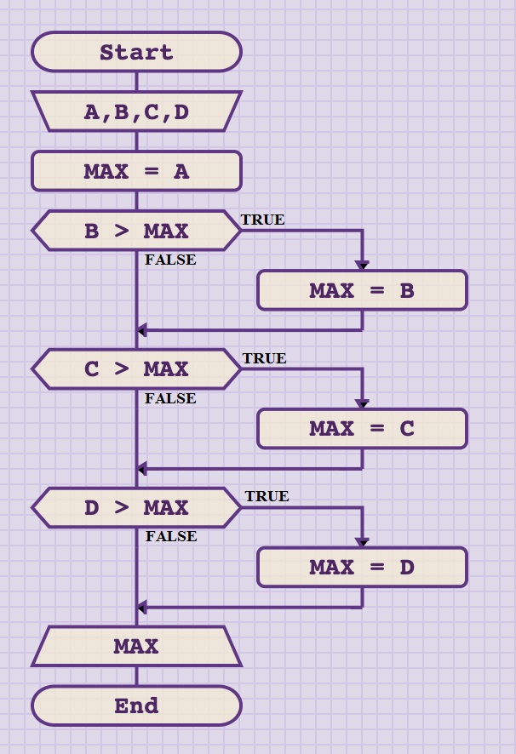
Branching algorithm 4 – max of 4
max of 4 - flowchart

Slide 68
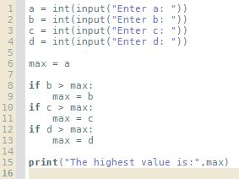
Branching algorithm 4 – max of 4
max of 4 – Python code

Slide 69

Branching algorithm 4 – max of 4
max of 4 – Python code and test

Slide 70
Branching algorithm 5 – triangle
EXERCISE: Ask user to enter 3 positive integers (A, B, C). Then check if sides A, B and C can form a triangle.
Rule:
A triangle cannot have one side longer than the sum of the other two.
Try to solve with SINGLE if statement.
Sketch the flowchart first.
Test the algorithm.
Implement in Python.
Time: 10 minutes.

Slide 71
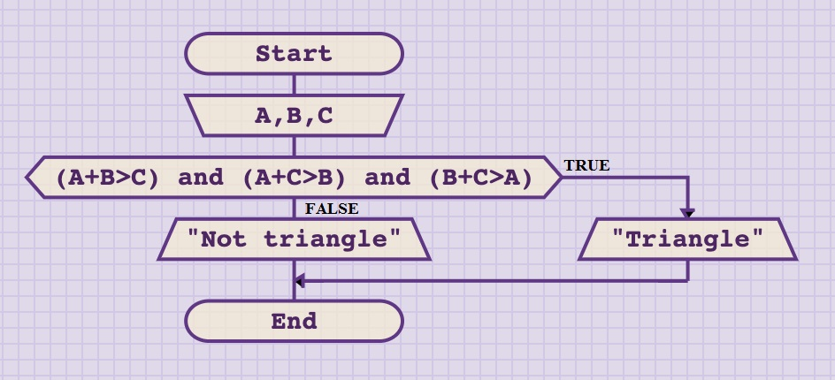
Branching algorithm 5 – triangle
solution - flowchart

Slide 72
Branching algorithm 6 – HR selection
EXERCISE: Your company is looking to hire a new developer. Your HR officers asks you to build a program to help screen the candidates. The program should ask for age and experience of prospective employee. The company is looking for experienced individuals, so any candidate with over 40 years of age, or with 10 or more years of experience is hired.
If these conditions are not met, then the candidate is given a test, where he / she can score 1 – 10 points. The program should then ask to enter test result and if above 8.5, the candidate is hired. Otherwise, the candidate should be rejected.
Design the algorithm. Create the flowchart, test all conditions and then implement in Python.
Time: 10 minutes.

Slide 73
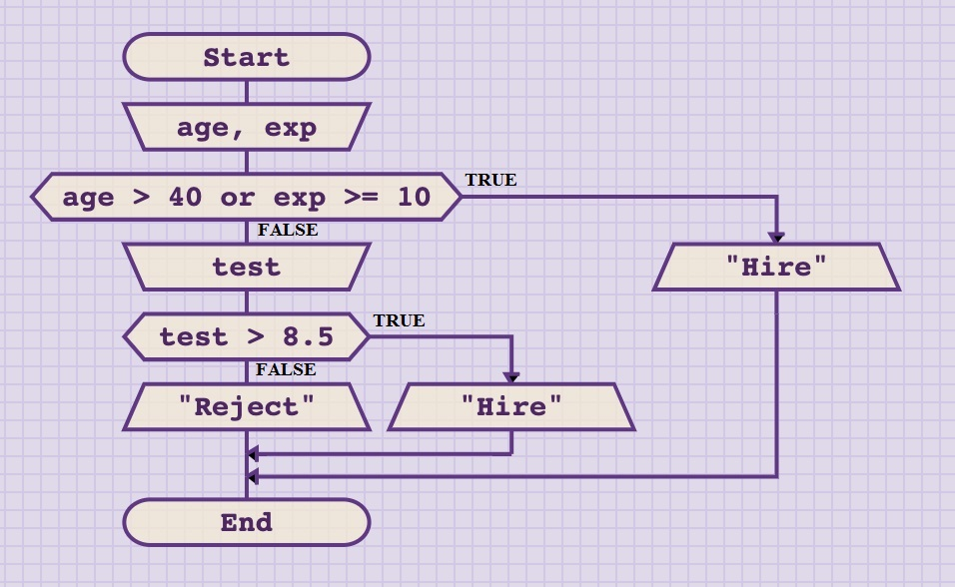
Branching algorithm 6 – HR selection
solution - flowchart

Slide 74
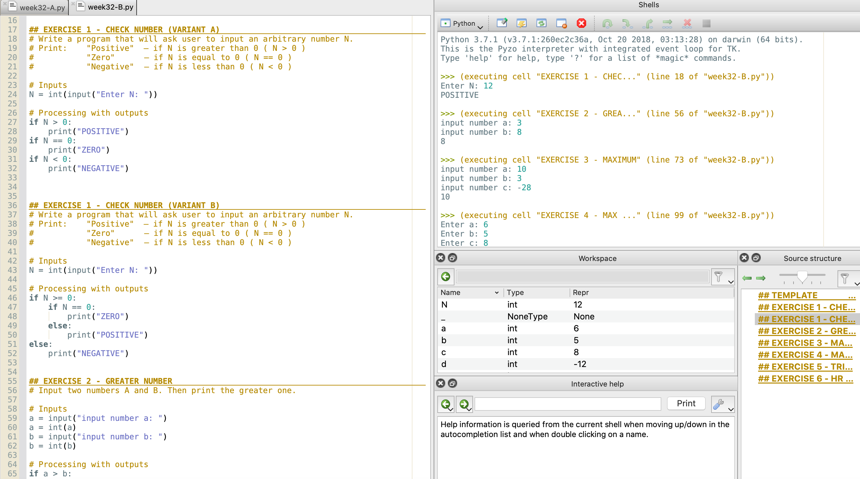
Code for the exercises 1-6
Python code for exercises 1-6 can be found in the file week32-B.py.
Either copy-paste each exercise into a new file and then run it.
Or comment out the parts you don’t need, and execute the entire file.
If you are using Pyzo, each exercise is given as a separate cell (starts with ##). You can run a single cell by clicking inside it and choosing Run → Execute cell from the menu.
Pyzo also allows you to highlight one section of the code and execute it line-by-line in the shell. For that option, highlight the code you want, then choose: Run → Execute selection.

Slide 75
Branching algorithm 7 – the highest odd number (measuring learning objectives)
Exercise:
From the book, exercise at the end of chapter 2.2 (page 16):
Write a program that examines three variables — x, y, and z — and prints the largest odd number among them. If none of them are odd, it should print a message to that effect (i.e. that there is none).

Slide 76
Summary Quiz
What values can Boolean variables take? What is the proper syntax to write those values in Python?
In which order does Python evaluate Boolean operators and, or and not?
If we want one segment of the expression to be evaluated first, how do we signal that to Python?
What are comparison operators? What value type do they return?
What is the difference between ‘=’ and ‘==’ operators?
What is the structure of IF statement in Python? What is executed under which condition?
What does ELSE mean if IF … ELSE … statement? When is the code after ELSE executed?
What are branching algorithms?

Slide 77
Summary
Boolean variables in Python can have only True and False values. The correct syntax is a word True / False, starting with a capital letter.
The order of evaluating Boolean operators in Python is: 1) not, 2) and, 3) or.
To ensure that (a section of) and expression is evaluated first, we can use parenthesis.
Comparison operators are operators used to compare two values. The result of comparison is a Boolean value.
‘=’ is assignment operator, while ‘==’ is comparison operator.
If statement contains keyword ‘if’, Boolean expression (condition) and the body of the statement (could be one ore multiple lines). If the expression is evaluated to be True, lines from the body will be executer. Otherwise they will be ignored.
Else in if … else … statement denotes the beginning of the part of the code which will be executed only if the expression is evaluated to NOT True (= False).
Branching algorithms are the type of algorithms that contain steps that will be either executed ONCE or NEVER

